Slide 1
Chapter 1 Introduction to Computers, Programs, and Java
1

Slide 2
Objectives
To review computer basics, programs, and operating systems (§§1.2-1.4).
To explore the relationship between Java and the World Wide Web (§1.5).
To distinguish the terms API, IDE, and JDK (§1.6).
To write a simple Java program (§1.7).
To display output on the console (§1.7).
To explain the basic syntax of a Java program (§1.7).
To create, compile, and run Java programs (§1.8).
(GUI) To display output using the JOptionPane output dialog boxes (§1.9).
2

Slide 3
What is a Computer?
A computer consists of a CPU, memory, hard disk, floppy disk, monitor, printer, and communication devices.
Computer are 2- bits digital machine, which consist of 2 bits, 0’s and 1’s.
3

Slide 4
CPU
The central processing unit (CPU) is the brain of a computer. It retrieves instructions from memory and executes them. The CPU speed is measured in megahertz (MHz), with 1 megahertz equaling 1 million pulses per second. The speed of the CPU has been improved continuously. If you buy a PC now, you can get an Intel Pentium 4 Processor at 3 gigahertz (1 gigahertz is 1000 megahertz).
4

Slide 5
Memory
Memory is to store data and program instructions for CPU to execute. A memory unit is an ordered sequence of bytes, each holds eight bits. A program and its data must be brought to memory before they can be executed. A memory byte is never empty, but its initial content may be meaningless to your program. The current content of a memory byte is lost whenever new information is placed in it.
5

Slide 6
Data Storage
Computer are 2- bits digital machine, which consist of 2 bits, 0’s and 1’s.
In 1950’s – the first Computer design was based on 8- bits machine.
Means 8 bits was representing a letter(ex: letter S) a number (ex: number 5) or Symbol (+, -, *, etc..) the following:
A-z
0-9
Symbol
In 1980’s - we needed more computing processing.
We had to expand the bits per letters, numbers and symbols.
We design and computers based on 16-bits machine.

Slide 7
Data Storage Cont..
In 1995’s – Big revolution happened by having Microsoft Operating system(OS).
we needed more computing processing since OS was consist of pictures, colors, icons, graphics, video, audio, etc…
We had to expand the bits per letters, numbers and symbols to graphics, Audio, videos, and be able to handle processing all the pictures, colors, and icons.
A-z
0-9
Symbol
Graphics, Colors, icons
Audio, Video,
We design the computers based on 32-bits machine.
In 2000 and beyond, as computer platform changed (the hardware architecture and OS), We design the computers based on 64-bits machine.

Slide 8
How Data is Stored?
Data of various kinds, such as numbers, characters, and strings, are encoded as a series of bits (zeros and ones). Computers use zeros and ones because digital devices have two stable states, which are referred to as zero and one by convention. The programmers need not to be concerned about the encoding and decoding of data, which is performed automatically by the system based on the encoding scheme. The encoding scheme varies. For example, character ‘J’ is represented by 01001010 in one byte.
Example of the binary number represent of decimal number such as 49 is 110001 or 5 is 000101. A small number such as three can be stored in a single byte. If computer needs to store a large number that cannot fit into a single byte, it uses a number of adjacent bytes. No two data can share or split a same byte. A byte is the minimum storage unit.
8

Slide 9
Storage Devices
Memory is volatile, because information is lost when the power is off. Programs and data are permanently stored on storage devices and are moved to memory when the computer actually uses them. There are three main types of storage devices:Disk drives (hard disks and floppy disks), CD drives (CD-R and CD-RW), and Tape drives.
9

Slide 10
Output Devices: Monitor
The monitor displays information (text and graphics). The resolution and dot pitch determine the quality of the display.
10

Slide 11
Monitor Resolution and Dot Pitch
resolution
The resolution specifies the number of pixels per square inch. Pixels (short for “picture elements”) are tiny dots that form an image on the screen. The resolution can be set manually. The higher the resolution, the sharper and clearer the image is. However, the image may be very small if you set high resolution on a small screen monitor. PC monitors are usually 15-inch, 17-inch, 19-inch, or 21-inch. For a 15-inch monitor, a comfortable resolution setting would be 640×480 (307,200 pixels).
dot pitch
The dot pitch is the amount of space between pixels. The smaller the dot pitch, the better the display.
11

Slide 12
Communication Devices
A regular modem uses a phone line and can transfer data in a speed up to 56,000 bps (bits per second). A DSL (digital subscriber line) also uses a phone line and can transfer data in a speed 20 times faster than a regular modem. A cable modem uses the TV cable line maintained by the cable company. A cable modem is as fast as a DSL. Network interface card (NIC) is a device to connect a computer to a local area network (LAN). The LAN is commonly used in business, universities, and government organizations. A typical type of NIC, called 10BaseT, can transfer data at 10 mbps (million bits per second).
12

Slide 13
Programs
Computer programs, known as software, are instructions to the computer.
You tell a computer what to do through programs. Without programs, a computer is an empty machine. Computers do not understand human languages, so you need to use computer languages to communicate with them.
Programs are written using programming languages.
13

Slide 14
Compiler
From Computer perspective, the Machine Languages consist of
O’s & 1’s are actually is a combination of lights On and Off or negative and positive or yes or no
Machine language High Level Language
Compiler
O’s & 1’s
Like Java, C, C++, etc..
Compilers are programs that translate and/or interpret your programming language into Machine Language and vice versa.
Such as Java compiler IDE(Integrated Development Environment) Eclipse, jGrasp, NetBean, etc..
Object code
Source code

Slide 15
Programming Languages
Machine Language Assembly Language High-Level Language
Machine language is a set of primitive instructions built into every computer. The instructions are in the form of binary code, so you have to enter binary codes for various instructions. Program with native machine language is a tedious process. Moreover the programs are highly difficult to read and modify. For example, to add two numbers, you might write an instruction in binary like this:
1101101010011010
15

Slide 16
Programming Languages
Machine Language Assembly Language High-Level Language
Assembly languages were developed to make programming easy. Since the computer cannot understand assembly language, however, a program called assembler is used to convert assembly language programs into machine code. For example, to add two numbers, you might write an instruction in assembly code like this:
ADDF3 R1, R2, R3
16

Slide 17
Programming Languages
Machine Language Assembly Language High-Level Language
The high-level languages are English-like and easy to learn and program. For example, the following is a high-level language statement that computes the area of a circle with radius 5:
area = 5 * 5 * 3.1415;
17

Slide 18
Popular High-Level Languages
COBOL (COmmon Business Oriented Language)
FORTRAN (FORmula TRANslation)
BASIC (Beginner All-purpose Symbolic Instructional Code)
Pascal (named for Blaise Pascal)
Ada (named for Ada Lovelace)
C (whose developer designed B first)
Visual Basic (Basic-like visual language developed by Microsoft)
Delphi (Pascal-like visual language developed by Borland)
C++ (an object-oriented language, based on C)
C# (a Java-like language developed by Microsoft)
Java (We use it in the book)
18

Slide 19
Compiling Source Code
A program written in a high-level language is called a source program. Since a computer cannot understand a source program. Program called a compiler is used to translate the source program into a machine language program called an object program. The object program is often then linked with other supporting library code before the object can be executed on the machine.
19

Slide 20
Operating Systems
The operating system (OS) is a program that manages and controls a computer’s activities. You are probably using Windows 98, NT, 2000, XP, or ME. Windows is currently the most popular PC operating system. Application programs such as an Internet browser and a word processor cannot run without an operating system.
20

Slide 21
Why Java?
The answer is that Java enables users to develop and deploy applications on the Internet for servers, desktop computers, and small hand-held devices. The future of computing is being profoundly influenced by the Internet, and Java promises to remain a big part of that future. Java is the Internet programming language.
Java is a general purpose programming language.
Java is the Internet programming language.
21

Slide 22
Java, Web, and Beyond
Java can be used to develop Web applications.
Java Applets
Java Web Applications
Java can also be used to develop applications for hand-held devices such as Palm and cell phones
22

Slide 23
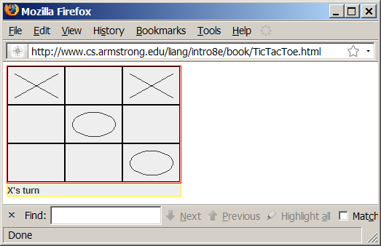
Examples of Java’s Versatility (Applets)
23

Slide 24
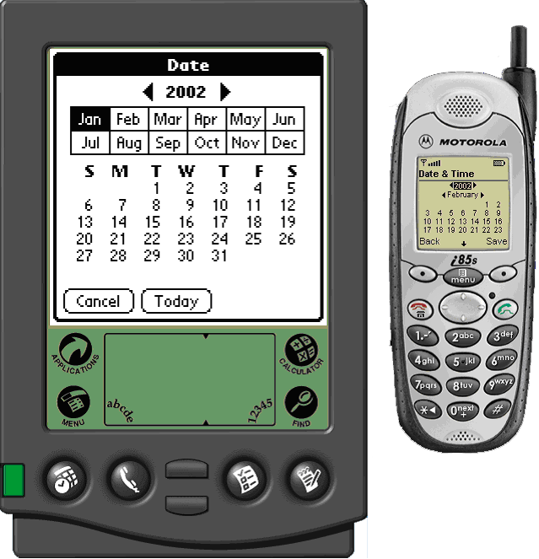
PDA and Cell Phone
24

Slide 25
Java’s History
James Gosling and Sun Microsystems
Oak
Java, May 20, 1995, Sun World
HotJava
The first Java-enabled Web browser
Early History Website:
http://java.sun.com/features/1998/05/birthday.html
25

Slide 26
Characteristics of Java
Companion Website
Java Is Simple
Java Is Object-Oriented
Java Is Distributed
Java Is Interpreted
Java Is Robust
Java Is Secure
Java Is Architecture-Neutral
Java Is Portable
Java's Performance
Java Is Multithreaded
Java Is Dynamic
www.cs.armstrong.edu/liang/intro8e/JavaCharacteristics.pdf
26

Slide 27
Characteristics of Java
Companion Website
Java Is Simple
Java Is Object-Oriented
Java Is Distributed
Java Is Interpreted
Java Is Robust
Java Is Secure
Java Is Architecture-Neutral
Java Is Portable
Java's Performance
Java Is Multithreaded
Java Is Dynamic
Java is partially modeled on C++, but greatly simplified and improved. Some people refer to Java as "C++--" because it is like C++ but with more functionality and fewer negative aspects.
27

Slide 28
Characteristics of Java
Companion Website
Java Is Simple
Java Is Object-Oriented
Java Is Distributed
Java Is Interpreted
Java Is Robust
Java Is Secure
Java Is Architecture-Neutral
Java Is Portable
Java's Performance
Java Is Multithreaded
Java Is Dynamic
Java is inherently object-oriented. Although many object-oriented languages began strictly as procedural languages, Java was designed from the start to be object-oriented. Object-oriented programming (OOP) is a popular programming approach that is replacing traditional procedural programming techniques. Java can be used as an application and applet. applet. http://java.sun.com/applets/
One of the central issues in software development is how to reuse code. Object-oriented programming provides great flexibility, modularity, clarity, and reusability through encapsulation, inheritance, and polymorphism.
28

Slide 29
Characteristics of Java
Companion Website
Java Is Simple
Java Is Object-Oriented
Java Is Distributed
Java Is Interpreted
Java Is Robust
Java Is Secure
Java Is Architecture-Neutral
Java Is Portable
Java's Performance
Java Is Multithreaded
Java Is Dynamic
Distributed computing involves several computers working together on a network. Java is designed to make distributed computing easy. Since networking capability is inherently integrated into Java, writing network programs is like sending and receiving data to and from a file.
29

Slide 30
Characteristics of Java
Companion Website
Java Is Simple
Java Is Object-Oriented
Java Is Distributed
Java Is Interpreted
Java Is Robust
Java Is Secure
Java Is Architecture-Neutral
Java Is Portable
Java's Performance
Java Is Multithreaded
Java Is Dynamic
You need an interpreter to run Java programs. The programs are compiled into the Java Virtual Machine code called bytecode. The bytecode is machine-independent and can run on any machine that has a Java interpreter, which is part of the Java Virtual Machine (JVM).
30

Slide 31
Characteristics of Java
Companion Website
Java Is Simple
Java Is Object-Oriented
Java Is Distributed
Java Is Interpreted
Java Is Robust
Java Is Secure
Java Is Architecture-Neutral
Java Is Portable
Java's Performance
Java Is Multithreaded
Java Is Dynamic
Java compilers can detect many problems that would first show up at execution time in other languages.
Java has eliminated certain types of error-prone programming constructs found in other languages.
Java has a runtime exception-handling feature to provide programming support for robustness.
31

Slide 32
Characteristics of Java
Companion Website
Java Is Simple
Java Is Object-Oriented
Java Is Distributed
Java Is Interpreted
Java Is Robust
Java Is Secure
Java Is Architecture-Neutral
Java Is Portable
Java's Performance
Java Is Multithreaded
Java Is Dynamic
Java implements several security mechanisms to protect your system against harm caused by stray programs.
32

Slide 33
Characteristics of Java
Companion Website
Java Is Simple
Java Is Object-Oriented
Java Is Distributed
Java Is Interpreted
Java Is Robust
Java Is Secure
Java Is Architecture-Neutral
Java Is Portable
Java's Performance
Java Is Multithreaded
Java Is Dynamic
Write once, run anywhere
With a Java Virtual Machine (JVM), you can write one program that will run on any platform.
33

Slide 34
Characteristics of Java
Companion Website
Java Is Simple
Java Is Object-Oriented
Java Is Distributed
Java Is Interpreted
Java Is Robust
Java Is Secure
Java Is Architecture-Neutral
Java Is Portable
Java's Performance
Java Is Multithreaded
Java Is Dynamic
Because Java is architecture neutral, Java programs are portable. They can be run on any platform without being recompiled.
34

Slide 35
Characteristics of Java
Companion Website
Java Is Simple
Java Is Object-Oriented
Java Is Distributed
Java Is Interpreted
Java Is Robust
Java Is Secure
Java Is Architecture-Neutral
Java Is Portable
Java's Performance
Java Is Multithreaded
Java Is Dynamic
Java’s performance Because Java is architecture neutral, Java programs are portable. They can be run on any platform without being recompiled.
35

Slide 36
Characteristics of Java
Companion Website
Java Is Simple
Java Is Object-Oriented
Java Is Distributed
Java Is Interpreted
Java Is Robust
Java Is Secure
Java Is Architecture-Neutral
Java Is Portable
Java's Performance
Java Is Multithreaded
Java Is Dynamic
Multithread programming is smoothly integrated in Java, whereas in other languages you have to call procedures specific to the operating system to enable multithreading.
36

Slide 37
Characteristics of Java
Companion Website
Java Is Simple
Java Is Object-Oriented
Java Is Distributed
Java Is Interpreted
Java Is Robust
Java Is Secure
Java Is Architecture-Neutral
Java Is Portable
Java's Performance
Java Is Multithreaded
Java Is Dynamic
Java was designed to adapt to an evolving environment. New code can be loaded on the fly without recompilation. There is no need for developers to create, and for users to install, major new software versions. New features can be incorporated transparently as needed.
37

Slide 38
JDK Versions
JDK 1.02 (1995)
JDK 1.1 (1996)
JDK 1.2 (1998)
JDK 1.3 (2000)
JDK 1.4 (2002)
JDK 1.5 (2004) a. k. a. JDK 5 or Java 5
JDK 1.6 (2006) a. k. a. JDK 6 or Java 6
JDK 1.7 (possibly 2010) a. k. a. JDK 7 or Java 7
38

Slide 39
JDK Editions
Java Standard Edition (J2SE)
J2SE can be used to develop client-side standalone applications or applets.
Java Enterprise Edition (J2EE)
J2EE can be used to develop server-side applications such as Java servlets and Java ServerPages.
Java Micro Edition (J2ME).
J2ME can be used to develop applications for mobile devices such as cell phones.
This book uses J2SE to introduce Java programming.
39

Slide 40
Popular Java IDEs
NetBeans Open Source by Sun
Eclipse Open Source by IBM
jGRASP is implemented in Java, and runs on all platforms with a Java Virtual Machine. Java Development Kit (JDK) contains a compiler, interpreter, and debugger. If you have not installed JDK, it is freely available from Sun Microsystems. You can download the latest version from the download section at http://java.sun.com. Make sure you download the JDK (or SDK) not the JRE (runtime environment) that matches the platform you use.
Java IDEs (Integrated Development Environment) such as Eclipse, JBuilder, or jGRASP are development environments
that make Java programming much faster and easier.
JDK consists set of separate programs for developing & testing Java programs.
IDE software that provides editing, compiling, building, debugging, and on-line help are integrated in one GUI.
40

Slide 41
Basic Java Codes
Public: It is a keyword/reserved word used in Java. A variable or a method that is declared public is publicly accessible to any member of the project. Any class or method can freely access other public methods and variables of another class.
Class: It is a keyword/reserved word used in Java. Java program consist of pieces called class. Classes are to objects as blueprint are to houses. Classes are the fundamental building blocks of a Java program. You can define an Employee class as follows.
Class Name: A class name is a user-defined identifier. A series of characters consisting of letters, digits, underscore(_) and dollars signs ($) that does not began with a digit and does not contain spaces. Public Class Welcome 1
Main Method: in order to run a class, the class must contain a method named main. The program is executed from the main method.
Main: The word main is not a keyword but it is name of method.
Static : Static means it does only associated with only this class.
Void: is a keyword that this method will not return any information. Later you will see how a method can return information.
Java is case sensitive – Uppercase and lowercase letters are distinct, so a1 and A1 are different identifier.
String[] args in parentheses is a required part of the methods main’s declaration. String of array of arguments. It allows main method to passed to the class.
41

Slide 42
A Simple Java Program
Listing 1.1
//This program prints Welcome to Java!
public class Welcome {
public static void main(String[] args) {
System.out.println("Welcome to Java!");
}
}
Welcome
IMPORTANT NOTE: (1) To enable the buttons, you must download the entire slide file slide.zip and unzip the files into a directory (e.g., c:\slide) . (2) You must have installed JDK and set JDK’s bin directory in your environment path (e.g., c:\Program Files\java\jdk1.6.0_14\bin in your environment path.
Run
42

Slide 43

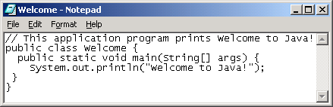
Creating and Editing Using NotePad
To use NotePad, type
notepad Welcome.java
from the DOS prompt.
The main method contains the System.our.println statement. This statement prints a message :”Welcome to Java!” to the console. Every statement in Java ends with a semicolon (;), know as the statement terminators.
43

Slide 44

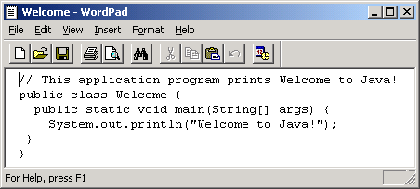
Creating and Editing Using WordPad
To use WordPad, type
write Welcome.java
from the DOS prompt.
44

Slide 45
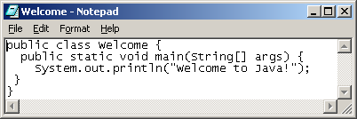
Creating, Compiling, and Running Programs
45

Slide 46
Compiling Java Source Code
You can port a source program to any machine with appropriate compilers. The source program must be recompiled, however, because the object program can only run on a specific machine. Nowadays computers are networked to work together. Java was designed to run object programs on any platform. With Java, you write the program once, and compile the source program into a special type of object code, known as bytecode. The bytecode can then run on any computer with a Java Virtual Machine, as shown below. Java Virtual Machine is a software that interprets Java bytecode.
46

Slide 47
Trace a Program Execution
animation
//This program prints Welcome to Java!
public class Welcome {
public static void main(String[] args) {
System.out.println("Welcome to Java!");
}
}
47

Slide 48
Trace a Program Execution
animation
//This program prints Welcome to Java!
public class Welcome {
public static void main(String[] args) {
System.out.println("Welcome to Java!");
}
}
48

Slide 49
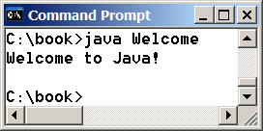
Trace a Program Execution
animation
//This program prints Welcome to Java!
public class Welcome {
public static void main(String[] args) {
System.out.println("Welcome to Java!");
}
}
49

Slide 50
Two More Simple Examples
Welcome1
public class Welcome1 { public static void main(String[] args) { System.out.println("Programming is fun!"); System.out.println("Fundamentals First"); System.out.println("Problem Driven"); }
Run
ComputeExpression
public class ComputeExpression { public static void main(String[] args) { System.out.println((10.5 + 2 * 3) / (45 - 3.5)); } }
Run
50

Slide 51
Supplements on the Companion Website
Companion Website
See Supplement I.B for installing and configuring JDK
See Supplement I.C for compiling and running Java from the command window for details
www.cs.armstrong.edu/liang/intro8e
51

Slide 52
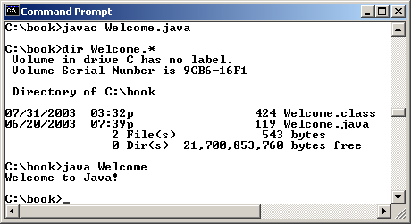
Compiling and Running Java from the Command Window
Companion Website
Set path to JDK bin directory
- set path=c:\Program Files\java\jdk1.6.0\bin
Set classpath to include the current directory
- set classpath=.
Compile
- javac Welcome.java
Run
- java Welcome
52

Slide 53
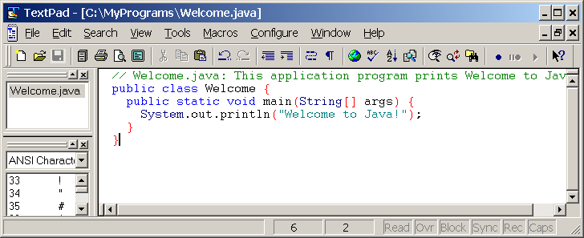
Compiling and Running Java from TextPad
Companion Website
See Supplement II.A on the Website for details
53

Slide 54
Anatomy of a Java Program
Comments
Reserved words
Modifiers
Statements
Blocks
Classes
Methods
The main method
54

Slide 55
Comments
Three types of comments in Java.
Line comment: A line comment is preceded by two slashes (//) in a line.
Paragraph comment: A paragraph comment is enclosed between /* and */ in one or multiple lines.
javadoc comment: javadoc comments begin with /** and end with */. They are used for documenting classes, data, and methods. They can be extracted into an HTML file using JDK's javadoc command.
55

Slide 56
Reserved Words
Reserved words or keywords are words that have a specific meaning to the compiler and cannot be used for other purposes in the program.
For example, when the compiler sees the word class, it understands that the word after class is the name for the class. Other reserved words in Listing 1.1 are public, static, and void. Their use will be introduced later in the book.
56

Slide 57
Modifiers
Java uses certain reserved words called modifiers that specify the properties of the data, methods, and classes and how they can be used.
Examples of modifiers are public and static. Other modifiers are private, final, abstract, and protected.
A public class, method, or class can be accessed by other programs. A private datum or method cannot be accessed by other programs. Modifiers are discussed in Chapter 6, “Objects and Classes.”
public class Welcome { public static void main(String[] args) {
57

Slide 58
Statements
A statement represents an action or a sequence of actions. The statement System.out.println("Welcome to Java!") in the program in Listing 1.1 is a statement to display the greeting "Welcome to Java!" Every statement in Java ends with a semicolon (;).
System.out.println("Welcome to Java!");
58

Slide 59
Blocks
A pair of braces in a program forms a block that groups components of a program.
59

Slide 60
Classes
The class is the essential Java construct. A class is a template or blueprint for objects. To program in Java, you must understand classes and be able to write and use them. The mystery of the class will continue to be unveiled throughout this book. For now, though, understand that a program is defined by using one or more classes.
public class Welcome {
60

Slide 61
Methods
What is System.out.println? It is a method: a collection of statements that performs a sequence of operations to display a message on the console. It can be used even without fully understanding the details of how it works. It is used by invoking a statement with a string argument. The string argument is enclosed within parentheses. In this case, the argument is "Welcome to Java!" You can call the same println method with a different argument to print a different message.
//main method begins execution of Java application
public static void main(String[] args) {
61

Slide 62
main Method
The main method provides the control of program flow. The Java interpreter executes the application by invoking the main method.
The main method looks like this:
public static void main(String[] args) {
// Statements;
}
62

Slide 63
Displaying Text in a Message Dialog Box
you can use the showMessageDialog method in the JOptionPane class. JOptionPane is one of the many predefined classes in the Java system, which can be reused rather than “reinventing the wheel.”
/** This application program displays Welcome to Java! * in a message dialog box. */ import javax.swing.JOptionPane; public class WelcomeInMessageDialogBox { public static void main(String[] args) { // Display Welcome to Java! in a message dialog box JOptionPane.showMessageDialog(null, "Welcome to Java!"); } }
WelcomeInMessageDialogBox
Run
63

Slide 64
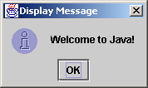
The showMessageDialog Method
JOptionPane.showMessageDialog(null,
"Welcome to Java!",
"Display Message",
JOptionPane.INFORMATION_MESSAGE);
Packages & Import
http://www.leepoint.net/notes-java/language/10basics/import.html
64

Slide 65
Two Ways to Invoke the Method
There are several ways to use the showMessageDialog method. For the time being, all you need to know are two ways to invoke it.
One is to use a statement as shown in the example:
JOptionPane.showMessageDialog(null, x,
y, JOptionPane.INFORMATION_MESSAGE);
where x is a string for the text to be displayed, and y is a string for the title of the message dialog box.
The other is to use a statement like this:
JOptionPane.showMessageDialog(null, x);
where x is a string for the text to be displayed.
65

